Slide 1
Hashed Alpha Testing
Chris Wyman
GDC 2017
Traditional Hashed

Slide 2
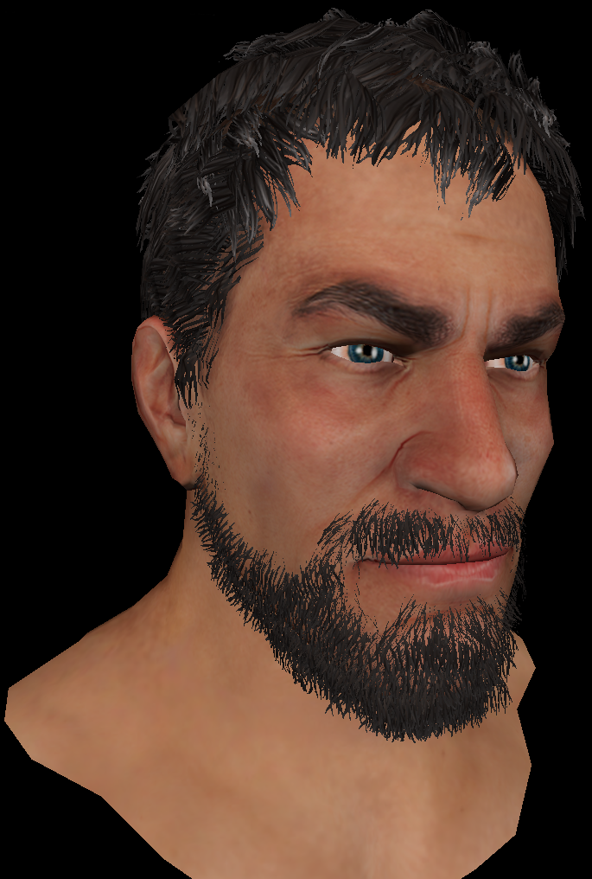
Why Alpha Test?
Alpha testing has advantages over alpha blend
Order independent, cheap, for forward or deferred
Extends to MSAA, via alpha-to-coverage

Slide 3
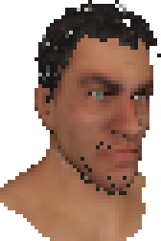
But… Problem
Alpha testing has advantages over alpha blend
Order independent, cheap, for forward or deferred
Extends to MSAA, via alpha-to-coverage
But alpha-tested geom can disappear w / distance

Slide 4
But… Problem
Alpha testing has advantages over alpha blend
Order independent, cheap, for forward or deferred
Extends to MSAA, via alpha-to-coverage
But alpha-tested geom can disappear w / distance
Why? Cannot prefilter binary queries

Slide 5
New Solution: Hashed Alpha
Use stochastic sampling to avoid this problem

Slide 6
New Solution: Hashed Alpha
Use stochastic sampling to avoid this problem
Basic idea is replace standard test:
With this stochastic test:

Slide 7
New Solution: Hashed Alpha
Use stochastic sampling to avoid this problem
Basic idea is replace standard test:
With this stochastic test:
But this flickers like crazy
Want temporal stability, esp. under slight motion
Use stable, procedural noise:

Slide 8
What Does this Look Like?
Alpha Test
Hashed Alpha
Ground Truth

Slide 9
Talk Takeaways
Stochasm addresses problems with alpha testing
Converges to ground truth (OIT) with enough random samples

Slide 10
Talk Takeaways
Stochasm addresses problems with alpha testing
Converges to ground truth (OIT) with enough random samples
Hashing can give noise stable over time

Slide 11
Talk Takeaways
Stochasm addresses problems with alpha testing
Converges to ground truth (OIT) with enough random samples
Hashing can give noise stable over time
By constraining hash inputs:
Control noise behavior
Ensure samples remain largely stable between frames

Slide 12
Talk Takeaways
Stochasm addresses problems with alpha testing
Converges to ground truth (OIT) with enough random samples
Hashing can give noise stable over time
By constraining hash inputs:
Control noise behavior
Ensure samples remain largely stable between frames
Also applies to alpha-to-coverage, screen-door transparency, etc.

Slide 13
Do Stochastic Alpha Thresholds Work?

Slide 14
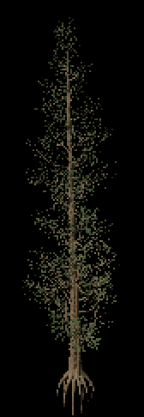
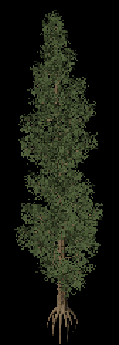
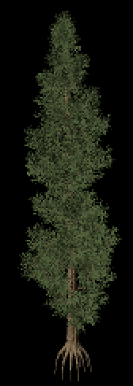
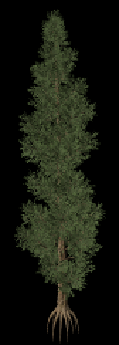
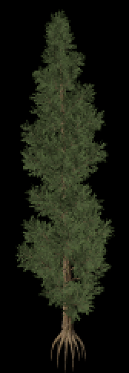
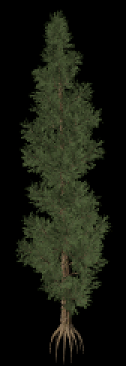
Stochastic Alpha Thresholds Work
Alpha test
1 sample
4 samples
16 samples
64 samples
OIT with
alpha blend

Slide 15
Stochastic Alpha Thresholds Work
Traditional Alpha
Alpha-to-Coverage
Stochastic Alpha (aka stochastic transparency)
1/2
1/8
1/8
1 sample, selected uniformly
on interval [0..1]
3/8
3/8
5/8
5/8
7/8
7/8
N samples, selected uniformly
on interval [0..1]
N samples, selected randomly
on interval [0..1]
Alpha test
1 sample
4 samples
16 samples
64 samples
OIT with
alpha blend

Slide 16
Stochastic Alpha Thresholds Work
Traditional Alpha
Alpha-to-Coverage
Stochastic Alpha (aka stochastic transparency)
1/2
1/8
1/8
1 sample, selected uniformly
on interval [0..1]
3/8
3/8
5/8
5/8
7/8
7/8
N samples, selected uniformly
on interval [0..1]
N samples, selected randomly
on interval [0..1]
But stochastic algorithms change each frame, causing severe temporal flickering!
Alpha test
1 sample
4 samples
16 samples
64 samples
OIT with
alpha blend

Slide 17
Why Hashing?
Hashing long known as a way of ‘randomizing’
See “Numerical Recipes” for an example PRNG using DES encryption

Slide 18
Why Hashing?
Hashing long known as a way of ‘randomizing’
See “Numerical Recipes” for an example PRNG using DES encryption
Good hash function properties:
Determinism given fixed input i.e., gives same value each frame
Defined range of outputs i.e., in range [0…1)
Uniformity over output range i.e., uniform outputs in range [0…1)

Slide 19
What Does This Mean?
Consider the following, with good hash function hash( ):
float hashSample = hash( myPosition );
Gives noisy hashSample like RNG per sample, but stays fixed between frames

Slide 20
What Does This Mean?
Consider the following, with good hash function hash( ):
float hashSample = hash( myPosition );
Gives noisy hashSample like RNG per sample, but stays fixed between frames
Important caveat! Tiny camera or object motions change hash sample, as
hash( myPosition ) ≠ hash( myPosition + Δ )
So these give different random values → flicker under motion

Slide 21
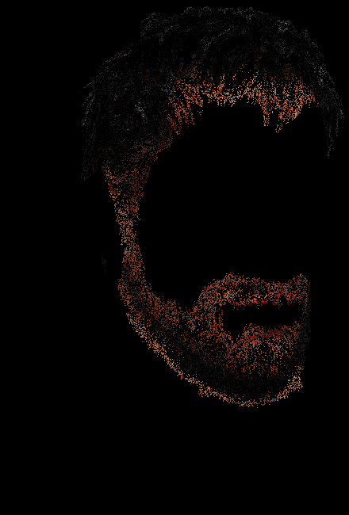
What Does “Stability” Look Like?
Frame-to-frame diff
Frame-to-frame diff
Unstable
Stable
Diff image under motion,
uncorrelated samples

Slide 22
Achieving Hash Stability
Key: Discretize hash inputs in appropriate coordinate frame
For small Δ:
hash( floor( myPosition ) ) = hash( floor( myPosition + Δ ) )
Tweaking this, allows us to control the scale of the stable noise, e.g.:
hash( floor( myPosition / scale ) * scale )

Slide 23
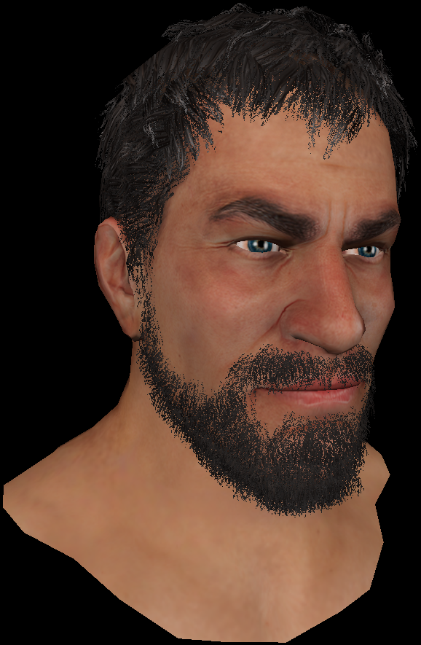
What Does A Hash Scale Look Like?
1x1 pixel scale 3x3 pixel scale 9x9 pixel scale

Slide 24
Key: Coordinate Choice For Hash Input
Need to discretize in appropriate coordinates
Same geometry should yield same hash, under:
Camera translation or rotation
Object translation or rotation
Ideally object skinning and deformation

Slide 25
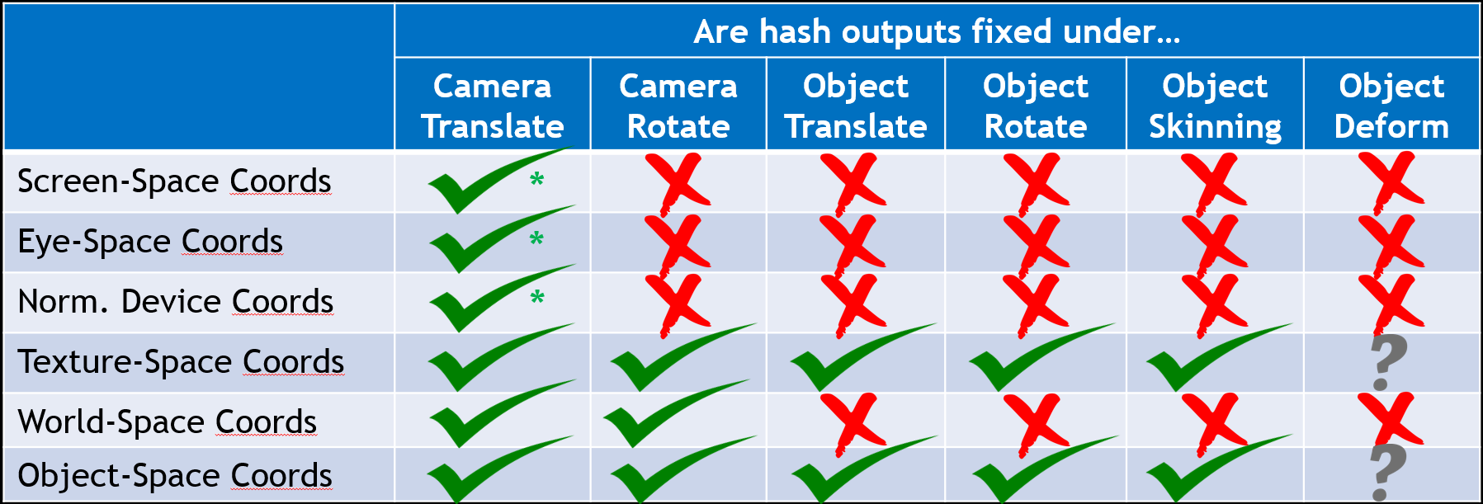
Key: Coordinate Choice For Hash Input
.’s work for deformation (and skinning) assuming hashing of pre-deformed coordinates
* = being somewhat generous

Slide 26
Key: Coordinate Choice For Hash Input
Clear choices:
.’s work for deformation (and skinning) assuming hashing of pre-deformed coordinates
* = being somewhat generous

Slide 27
Key: Coordinate Choice For Hash Input
We selected object coordinates; can discuss why, offline
.’s work for deformation (and skinning) assuming hashing of pre-deformed coordinates
* = being somewhat generous

Slide 28
Hashed Alpha Test Code

Slide 29
Hashed Alpha Test Code
Compute ideal scale to get 1-pixel sized noise

Slide 30
Hashed Alpha Test Code
Compute ideal scale to get 1-pixel sized noise
Use 2 scales, one smaller & one larger than
desired scale; akin to mipmapping

Slide 31
Hashed Alpha Test Code
Compute ideal scale to get 1-pixel sized noise
Use 2 scales, one smaller & one larger than
desired scale; akin to mipmapping
Compute hashed noise samples at 2 discrete scales

Slide 32
Hashed Alpha Test Code
Compute ideal scale to get 1-pixel sized noise
Use 2 scales, one smaller & one larger than
desired scale; akin to mipmapping
Compute hashed noise samples at 2 discrete scales
Linearly interpolate between noise scales

Slide 33
Hashed Alpha Test Code
Compute ideal scale to get 1-pixel sized noise
Use 2 scales, one smaller & one larger than
desired scale; akin to mipmapping
Compute hashed noise samples at 2 discrete scales
Linearly interpolate between noise scales
Interpolating between two uniform distributions
does not give a new uniform distribution
This math corrects for this non-uniformity

Slide 34
Hashed Alpha Test Code
Compute ideal scale to get 1-pixel sized noise
Use 2 scales, one smaller & one larger than
desired scale; akin to mipmapping
Compute hashed noise samples at 2 discrete scales
Linearly interpolate between noise scales
Interpolating between two uniform distributions
does not give a new uniform distribution
This math corrects for this non-uniformity
Clamp; alpha threshold of 0 makes no sense

Slide 35
Hashed Alpha Test Code
Specific hash not important, if uniform and
takes R³ → [0…1)
We use:

Slide 36
Hashed Alpha Test Code
User parameter to control size of noise:
1.0 = roughly pixel sized noise
2.0 = roughly 2x2 pixel sized noise

Slide 37
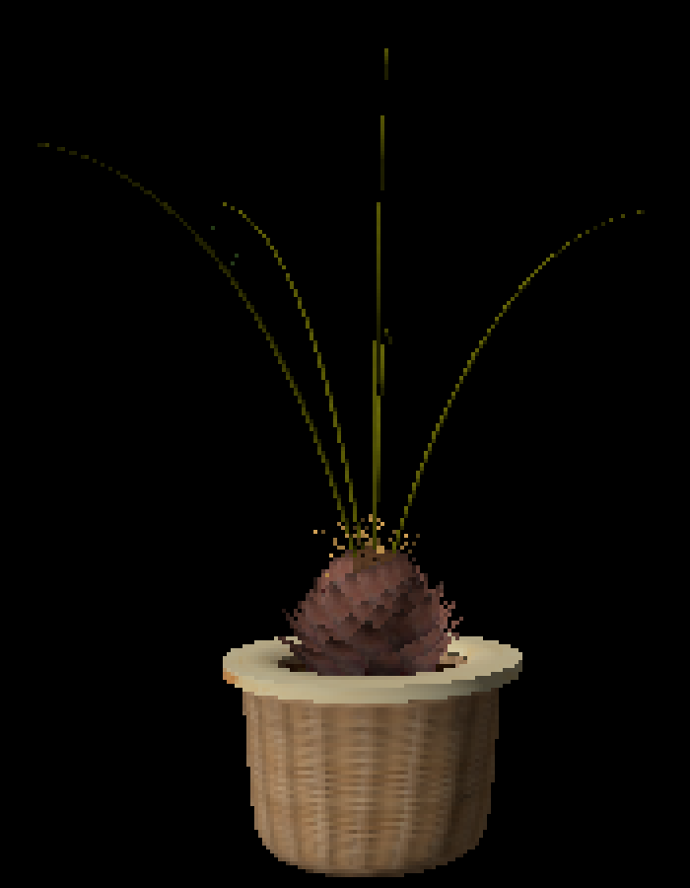
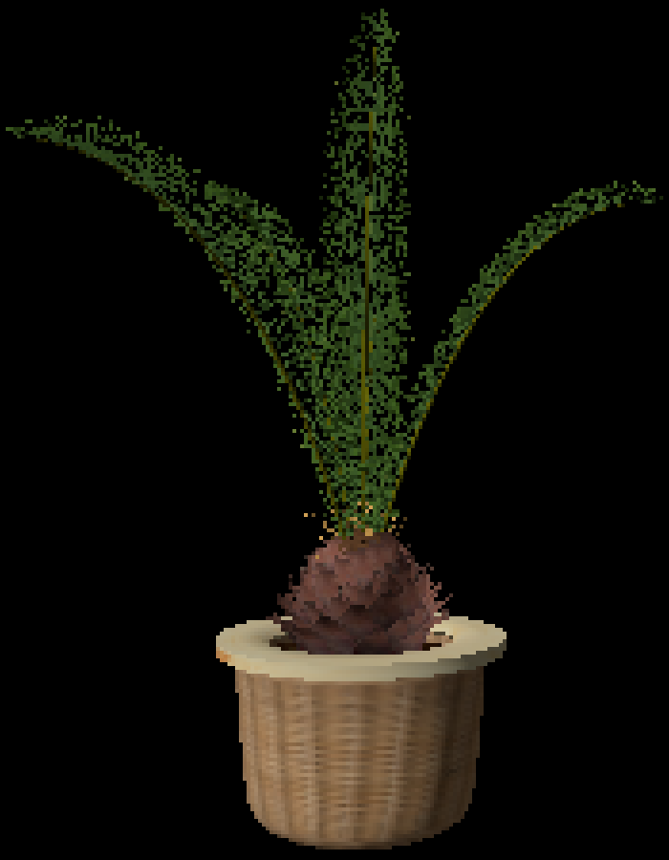
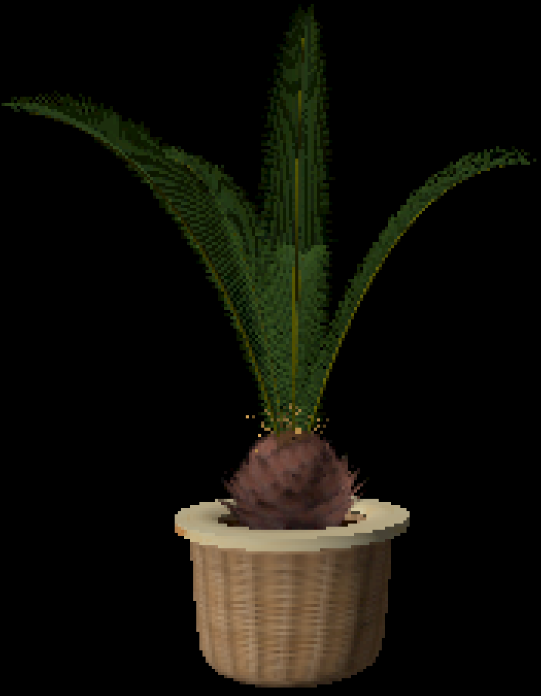
Results
Alpha test α_{t} = 0.5
Hashed alpha test
Ground truth OIT
0.06 ms @ 1024²
0.08 ms @ 1024²
1.3 ms @ 1024²
Performances not optimized; only demonstrative of relative costs

Slide 38
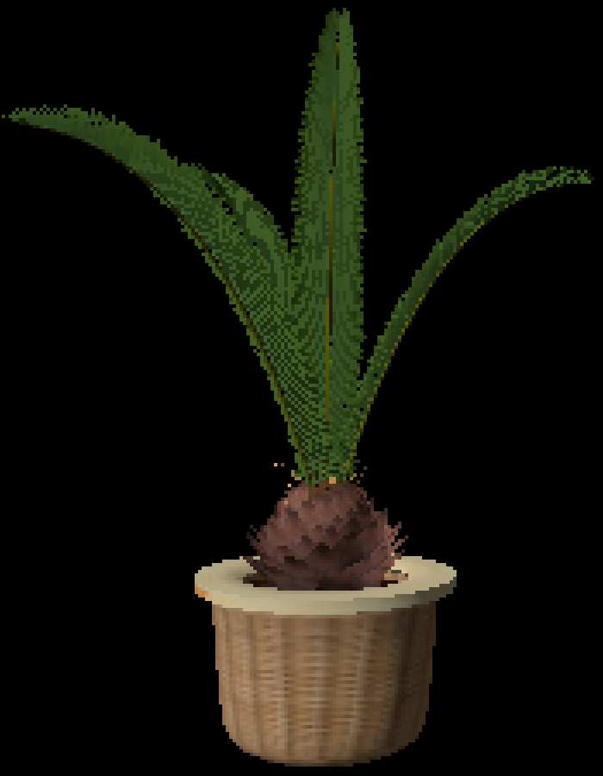
Results
Adjust alpha [Castaño 2010]
Hashed alpha test
Ground truth OIT
0.06 ms @ 1024²
0.08 ms @ 1024²
1.3 ms @ 1024²
Performances not optimized; only demonstrative of relative costs

Slide 39
But Not Just Alpha!

Slide 40
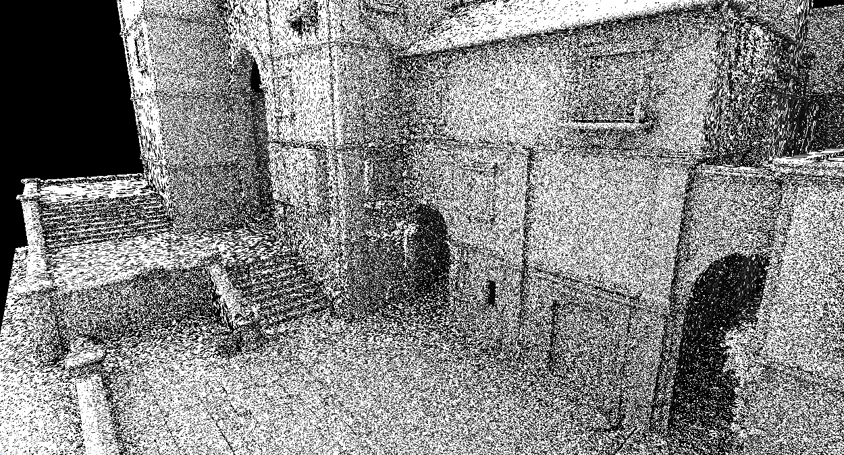
Hashed Sampling Has Other Uses

Slide 41
Hashed Sampling Has Other Uses
Shows there’s a problem with anisotropic hashing!

Slide 42
Hashed Sampling Has Other Uses
Can be addressed, mostly, by updating hash inputs

Slide 43
Hashing At Grazing Angles
Alpha test
Hashed alpha
Anisotropic
hashed alpha

Slide 44
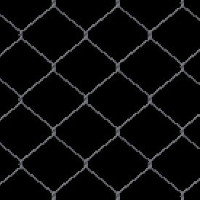
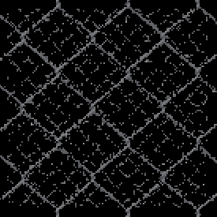
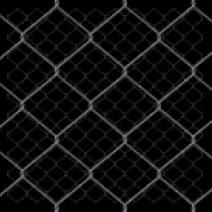
Results
Alpha test α_{t} = 0.5
Hashed alpha test
Ground truth OIT

Slide 45
Results
Alpha test α_{t} = 0.5
Hashed alpha test
Ground truth OIT
Might ask:
Do I want noise nearby?
(Alpha test is OK here)

Slide 46
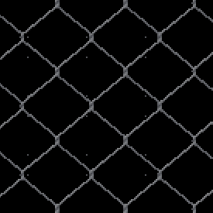
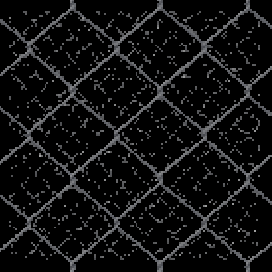
Results
Adjust alpha [Castaño 2010]
Hashed alpha test
(Faded in with LOD)
Ground truth OIT

Slide 47
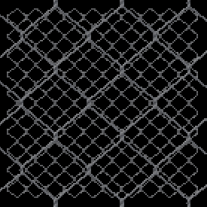
Results
Per-LOD threshold adjust
(Manual, “artist” driven)
Hashed alpha test
(Faded in with LOD)
Ground truth OIT

Slide 48
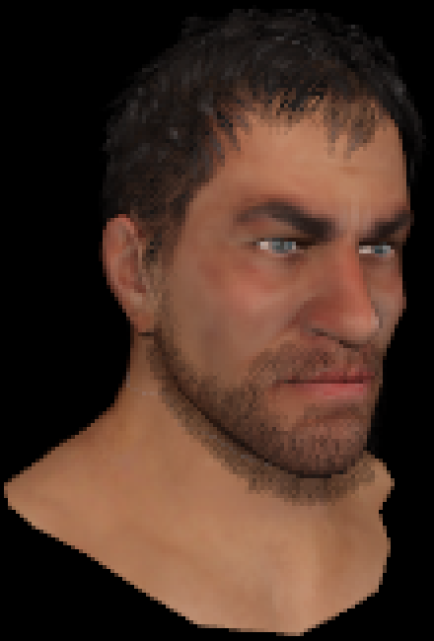
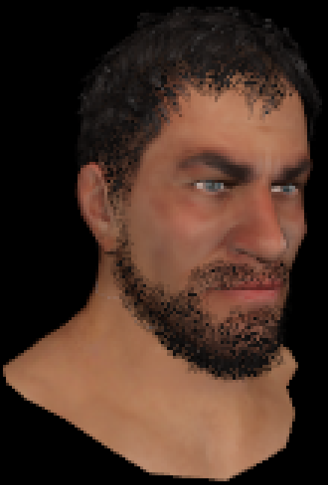
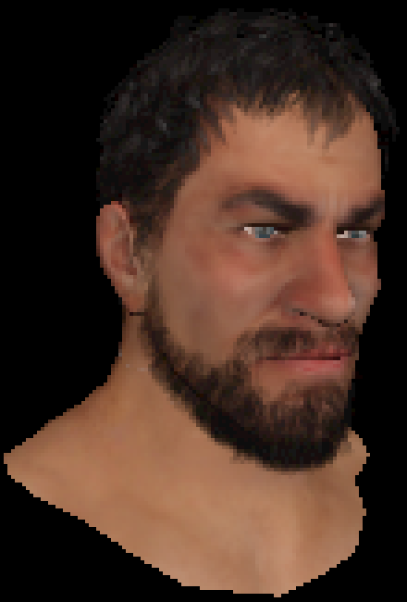
Helps With MSAA and A2C
8x alpha-to-coverage
8x hashed alpha-to-
coverage
Ground truth OIT

Slide 49
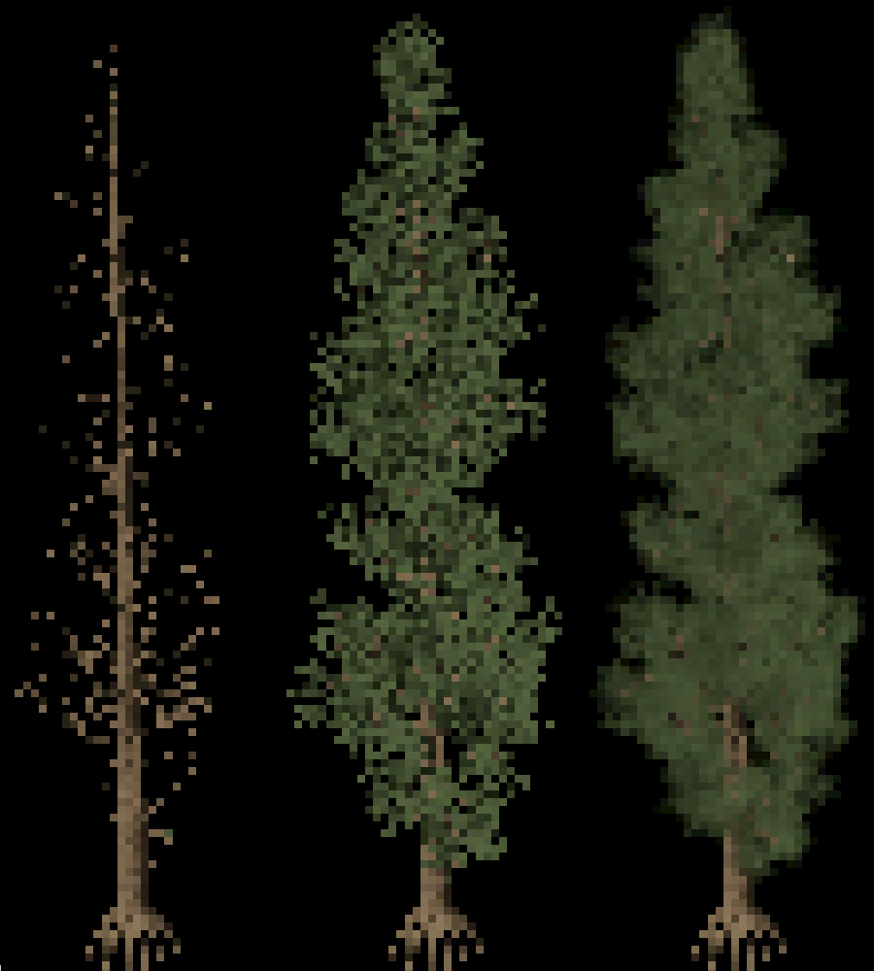
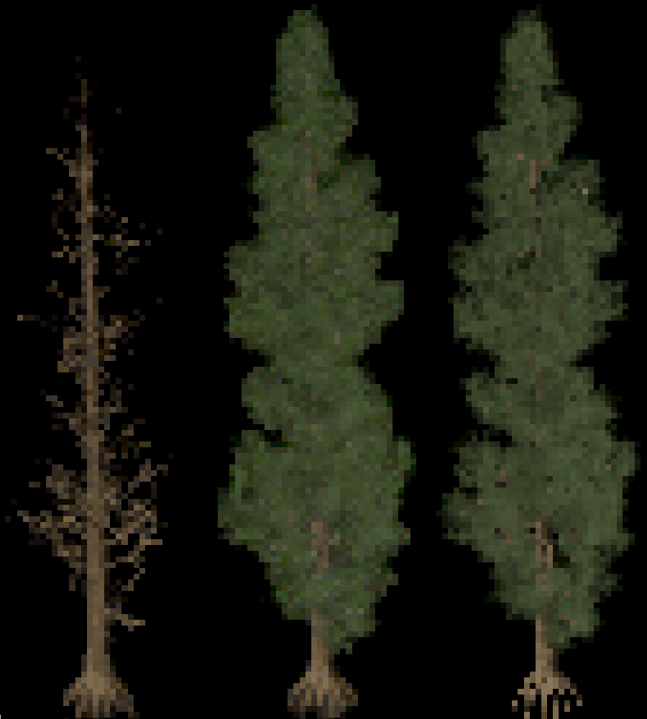
Temporal Antialiasing
No Temporal Antialiasing
With Temporal Antialiasing
Alpha Hashed Alpha Ground Truth
Alpha Hashed Alpha Ground Truth

Slide 50
Temporal Antialiasing
Might think, “based on stochastic sampling; of course TAA works well!”
But hashed alpha designed for stability under tiny camera motions, e.g. TAA jitter

Slide 51
Temporal Antialiasing
Might think, “based on stochastic sampling; of course TAA works well!”
But hashed alpha designed for stability under tiny camera motions, e.g. TAA jitter
A couple approaches:
Reduce global noise scale to < 1 pixel
TAA integrates sub pixel noise samples
Jitter offset in hash space;
Hash on objPos+offset[i] rather than objPos for relatively large, uncorrelated offset[i]
Jitter the alpha threshold
Compute α_{T} = hash( objPos ), use thresholds fract( α_{T} + i/N ) for i in [0…N)

Slide 52
Summary
Introduce new approach for alpha testing:
Alpha threshold cheaply & procedurally selected via a hash function
Gives stable noise; roughly as stable as traditional alpha test

Slide 53
Summary
Introduce new approach for alpha testing:
Alpha threshold cheaply & procedurally selected via a hash function
Gives stable noise; roughly as stable as traditional alpha test
Still use one alpha test per pixel, allowing:
Use in both deferred and forward pipelines
Run on older hardware; no new (or recent) features required

Slide 54
Summary
Introduce new approach for alpha testing:
Alpha threshold cheaply & procedurally selected via a hash function
Gives stable noise; roughly as stable as traditional alpha test
Still use one alpha test per pixel, allowing:
Use in both deferred and forward pipelines
Run on older hardware; no new (or recent) features required
Requires nothing in asset pipeline
Directly uses mip-chain’s alpha channels representing pre-filtered visibility

Slide 55
For Questions:
Email: cwyman@nvidia.com Twitter: @_cwyman_
Paper: http://www.cwyman.org/papers/i3d17_hashedAlpha.pdf
Thanks!
Alpha test
Hashed alpha test
Alpha blend

